Slide 1
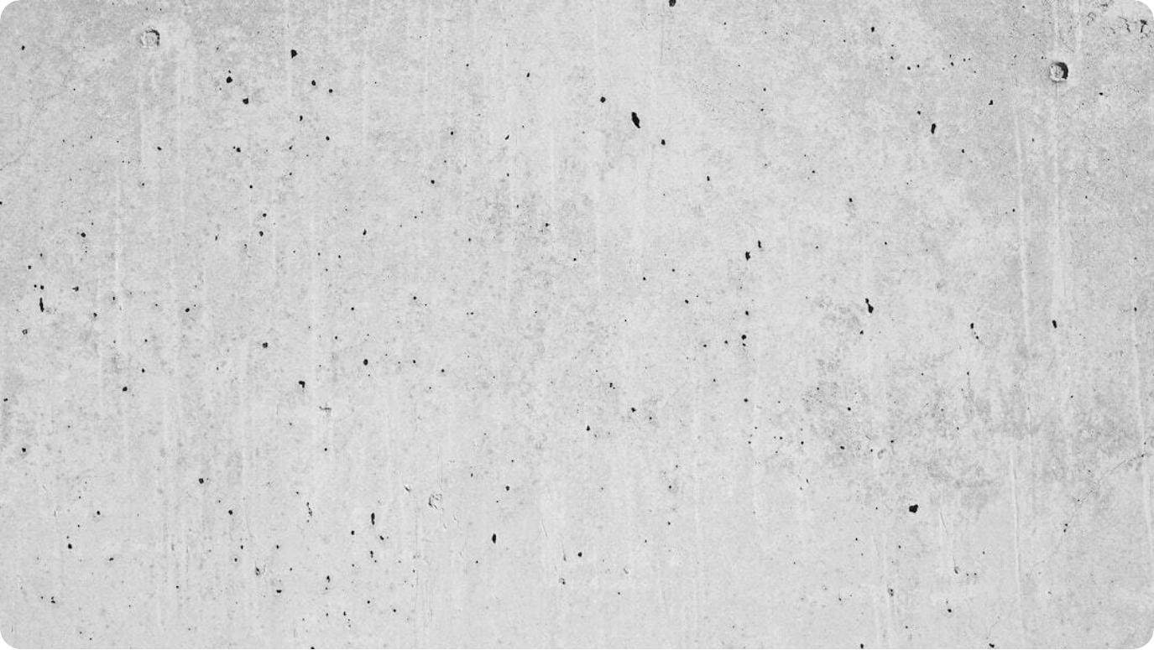
The Versatility of PVC: A Building Material Analysis
Exploring Polyvinyl Chloride in Construction
CLASS - B.ARCH (5TH SEM)
SUBJECT – B.C.M.
TOPIC - ABOUT PVC
SUBMITTED TO – SUDARSHANA MAM
SUBMITTED BY - PREETI
COLLAGE – GANGA INSTITUTE OF ARCHITECTURE & TOWN PLANNING
Photo by Wesley Tingey on Unsplash
Notes:
Welcome to this presentation on the versatility of PVC as a building material. This opening slide sets the stage for an in-depth analysis of Polyvinyl Chloride, its applications, advantages, and how it compares with other materials in modern construction.
The goal here is to establish PVC not just as a cost-effective alternative, but as a high-performance option that continues to shape contemporary building practices. With its wide range of uses, from plumbing to roofing, PVC has earned a reputation as one of the most adaptable materials in the construction industry.
This presentation, prepared by Preeti, will guide you through the material’s unique characteristics, real-world applications, and comparative analysis with aluminum.

Slide 2




What is PVC?
Definition and Key Characteristics
Definition
PVC, or Polyvinyl Chloride, is a synthetic plastic polymer made by polymerizing vinyl chloride.
Lightweight & Durable
Offers high strength-to-weight ratio and longevity in diverse applications.
Cost-Effective
Affordable compared to traditional building materials with reduced installation costs.
Versatile
Rigid and strong as uPVC; flexible and soft when plasticized.
Notes:
Polyvinyl Chloride, or PVC, is a synthetic polymer produced through the polymerization of vinyl chloride monomers. It is one of the most widely used plastics globally, owing to its balance of cost, strength, and adaptability.
One of the key characteristics of PVC is that it is lightweight yet remarkably durable, making it ideal for construction uses where both transportability and longevity matter. Its affordability compared to wood, metal, or concrete makes it a popular material for cost-conscious projects.
Importantly, PVC can exist in multiple forms. As unplasticized PVC, or uPVC, it is strong and rigid, used for window frames and doors. In contrast, plasticized PVC is softer and more flexible, often employed in flooring and wiring insulation. This duality underpins PVC’s versatility across industries.

Slide 3
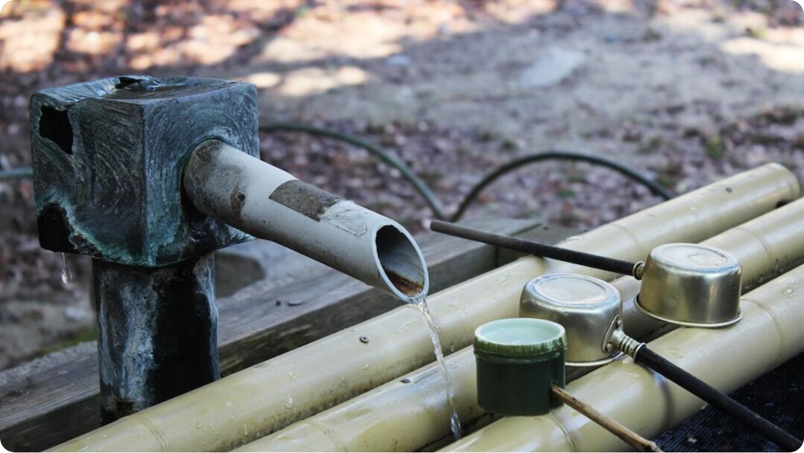
Advantages of PVC
Durability, Cost-Effectiveness, and Low Maintenance
Durability: PVC resists corrosion, rust, and chemical degradation. It endures harsh weather conditions, ensuring long-term service.
Cost-Effectiveness: Significantly more affordable than many traditional materials, lowering both purchase and installation costs.
Low Maintenance: Requires no painting, sealing, or frequent repairs, making it ideal for low-effort upkeep.
Photo by Lily Li on Unsplash
Notes:
One of the most important advantages of PVC is its remarkable durability. Unlike metals, it does not rust or corrode, and unlike wood, it does not warp or decay when exposed to moisture. This makes it exceptionally reliable for long-term construction projects.
PVC is also highly cost-effective. Its production costs are lower compared to materials like steel or aluminum, and installation is quicker and cheaper due to its lightweight nature. These savings compound over the life of a building.
Another defining benefit is its low maintenance. Unlike wood, which may require painting or varnishing, or metals that need protective coatings, PVC holds its properties with minimal upkeep. This translates to reduced life-cycle costs and ease of ownership for builders and occupants alike.

Slide 4
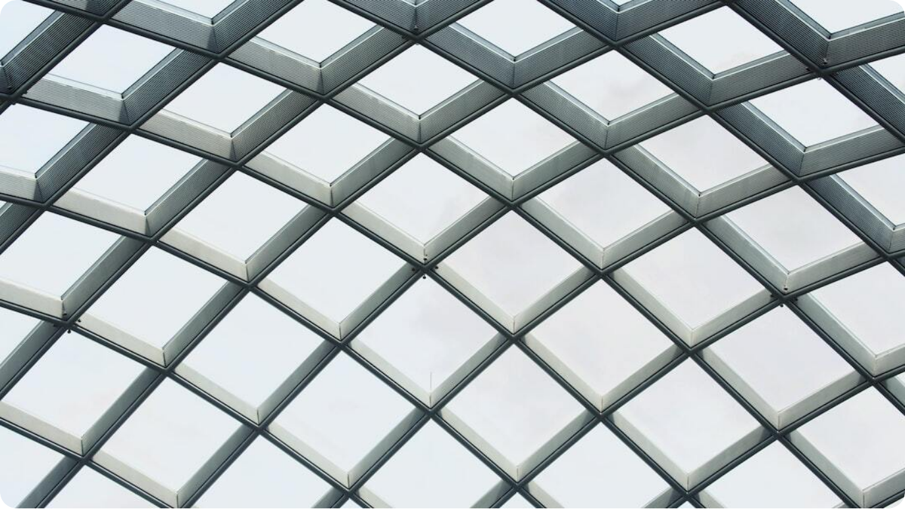
More Advantages of PVC
Lightweight, Recyclable, and Fire-Resistant
Lightweight: PVC’s low weight simplifies transport, handling, and installation, saving time and labor.
Recyclability: As a thermoplastic, PVC can be reprocessed into new products, promoting sustainability.
Fire Resistance: Inherently flame-retardant, PVC will not sustain combustion and is widely used for electrical protection.
Photo by Anthony Chiado on Unsplash
Notes:
Another critical advantage of PVC is its lightweight nature. This makes it far easier to transport and install compared to heavier alternatives like steel or concrete. This property reduces labor costs and accelerates project timelines.
PVC is also recyclable. Being a thermoplastic, it can be melted down and reshaped into new products multiple times without significant loss of performance. This aligns well with global efforts to move towards circular economies and sustainable construction practices.
Lastly, PVC is inherently flame-retardant. It does not easily ignite and will self-extinguish once the source of fire is removed. This makes it an excellent choice for applications like electrical wiring conduits, where fire safety is paramount.

Slide 5



Examples of PVC Use
Pipes and Fittings
Plumbing Systems
PVC pipes are extensively used in water supply, drainage, and sewage systems.
Non-Corrosive
PVC does not corrode or rust, ensuring clean and safe water transport.
Non-Toxic
Safe for potable water applications due to its chemical resistance and inertness.
Notes:
One of the most common and impactful applications of PVC is in piping systems. Its non-corrosive properties make it ideal for transporting water in supply lines, drainage, and sewage networks.
Unlike metal pipes, PVC pipes do not rust, corrode, or scale internally, which ensures clean and safe water delivery over long periods. This reliability has made PVC the standard in plumbing across much of the world.
Additionally, PVC is chemically inert and non-toxic, making it perfectly suited for potable water supply systems. These qualities combine to reduce health risks, extend service life, and lower maintenance needs.

Slide 6



Examples of PVC Use
Window Frames and Doors (uPVC)
uPVC Material
Unplasticized PVC provides rigidity and strength, ideal for windows and doors.
Thermal Insulation
Excellent insulation reduces energy consumption for heating and cooling.
Durability
uPVC resists moisture, rot, and UV degradation, ensuring long-lasting performance.
Notes:
Another major application of PVC, specifically unplasticized PVC (uPVC), is in window frames and doors. This rigid form of PVC is engineered for strength and structural stability, making it a preferred choice over traditional wood.
One of its defining features is superior thermal insulation. uPVC helps reduce heat loss in colder climates and minimizes heat gain in warmer ones, cutting energy costs significantly over time.
Additionally, uPVC does not warp, swell, or deteriorate under prolonged exposure to sunlight or moisture. These qualities make it particularly effective in providing long-term performance in diverse environmental conditions.

Slide 7
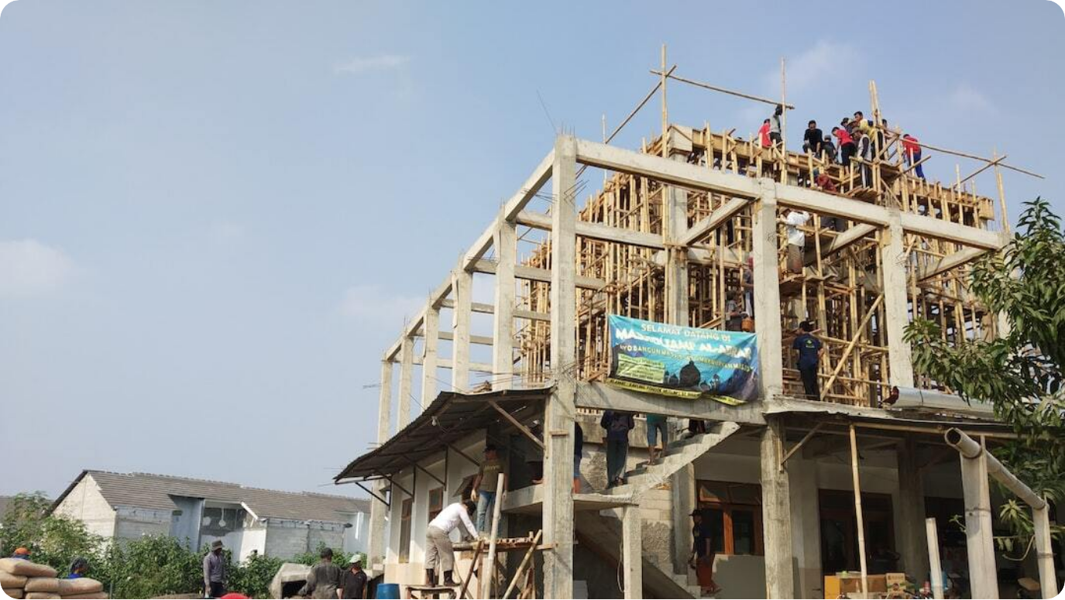
PVC as a Building Material
Introduction to Construction Uses
Cornerstone of Modern Construction: PVC is widely used across construction due to its unique blend of strength, cost-efficiency, and adaptability.
Replaces Traditional Materials: PVC often substitutes wood, concrete, or metal in applications requiring durability and low maintenance.
Versatile Applications: From piping to cladding, PVC is applied in nearly every aspect of building design.
Photo by Zuhud EM on Unsplash
Notes:
PVC has become a cornerstone of modern construction, valued for its combination of low cost, strength, and adaptability. Its role in the industry continues to expand as more builders prioritize cost efficiency and sustainability.
Traditionally, materials like wood, concrete, and metal were the go-to choices. However, PVC often outperforms them in terms of durability, maintenance, and overall lifecycle costs.
Because of its versatility, PVC finds applications in nearly every construction domain, from plumbing and roofing to window systems and exterior cladding. It truly embodies the concept of a 'multi-purpose material' for the built environment.

Slide 8
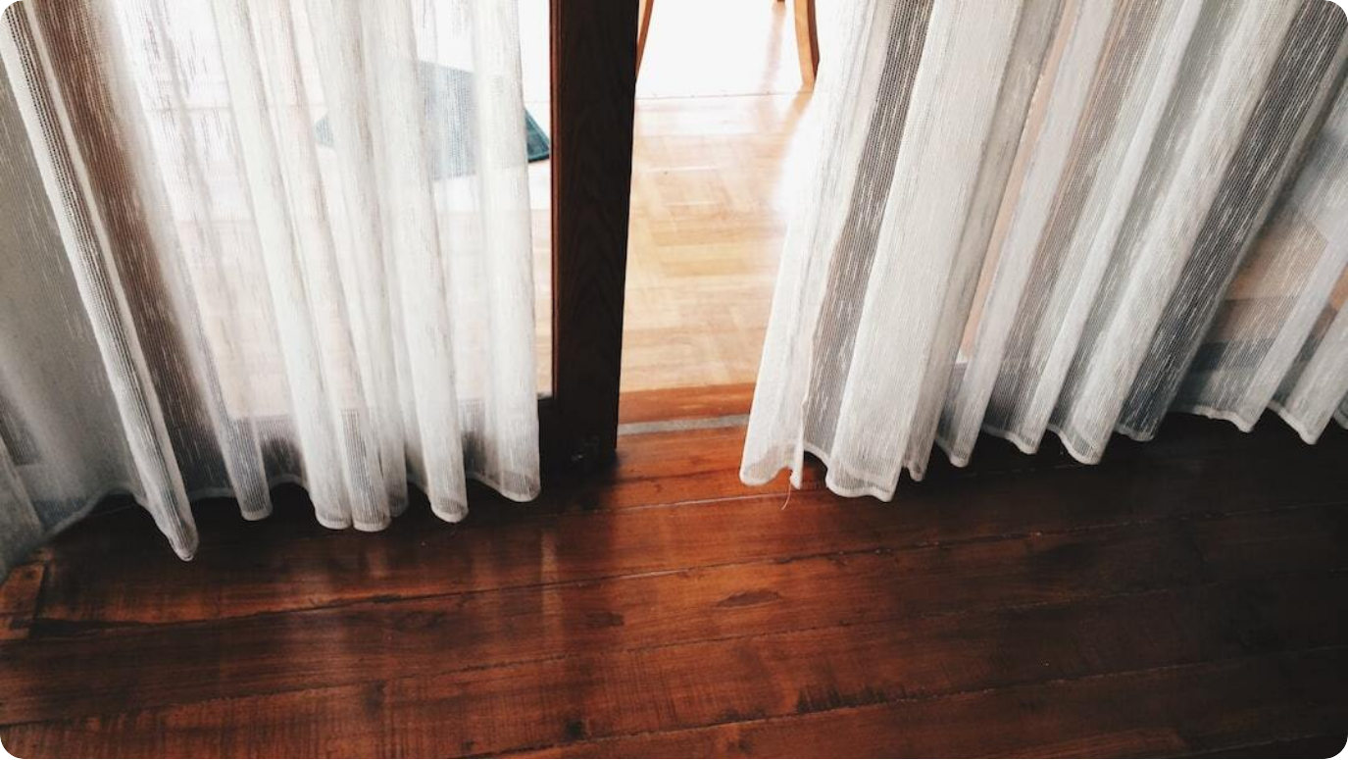
Specific Uses in Detail
PVC Flooring
Multiple Forms: PVC flooring is available as vinyl sheets, tiles, and planks.
Waterproof & Durable: Resistant to moisture, scratches, and wear, making it ideal for high-traffic areas.
Design Variety: Wide range of colors and patterns with comfort underfoot.
Photo by Nabila Fauzia on Unsplash
Notes:
PVC flooring is one of the most popular uses of this material in interior design. Available in different forms—such as sheets, tiles, and planks—it provides flexibility for both residential and commercial installations.
A key strength of PVC flooring is its waterproof nature, making it suitable for kitchens, bathrooms, and basements. It is also highly durable, resisting scratches, stains, and daily wear, which makes it ideal for high-traffic areas.
Another attractive feature is its design versatility. PVC flooring comes in a wide range of colors and patterns, often mimicking natural wood or stone. Beyond aesthetics, it provides a level of comfort underfoot that hard surfaces like ceramic tiles cannot match.

Slide 9
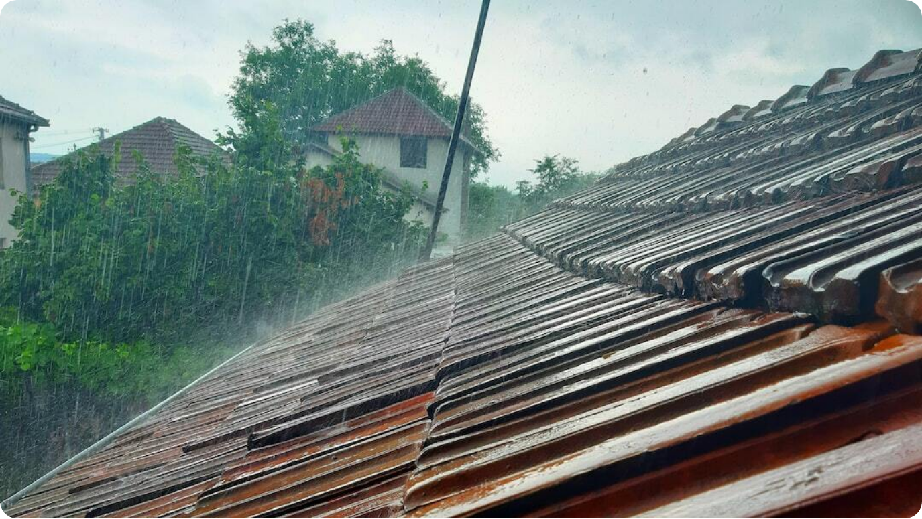
Specific Uses in Detail
PVC Roofing Membranes
Flat & Low-Slope Roofs: PVC membranes are ideal for flat or low-slope roofing applications.
Heat-Welded Seams: Seams are fused to create watertight, durable, and puncture-resistant layers.
Energy Efficiency: Reflects solar radiation, reducing heat absorption and lowering cooling costs.
Photo by N T on Unsplash
Notes:
PVC roofing membranes are widely used in commercial and industrial buildings, particularly for flat or low-slope roofs. These membranes are engineered to withstand tough environmental conditions and provide long-lasting protection.
The seams of PVC roofing are heat-welded, which makes them exceptionally watertight and resistant to punctures. This ensures durability against weather extremes and extends the roof's service life.
Beyond durability, PVC roofs offer energy efficiency by reflecting solar radiation. This reduces heat absorption, helping lower air conditioning costs in large facilities, and contributes to sustainable building certifications.

Slide 10
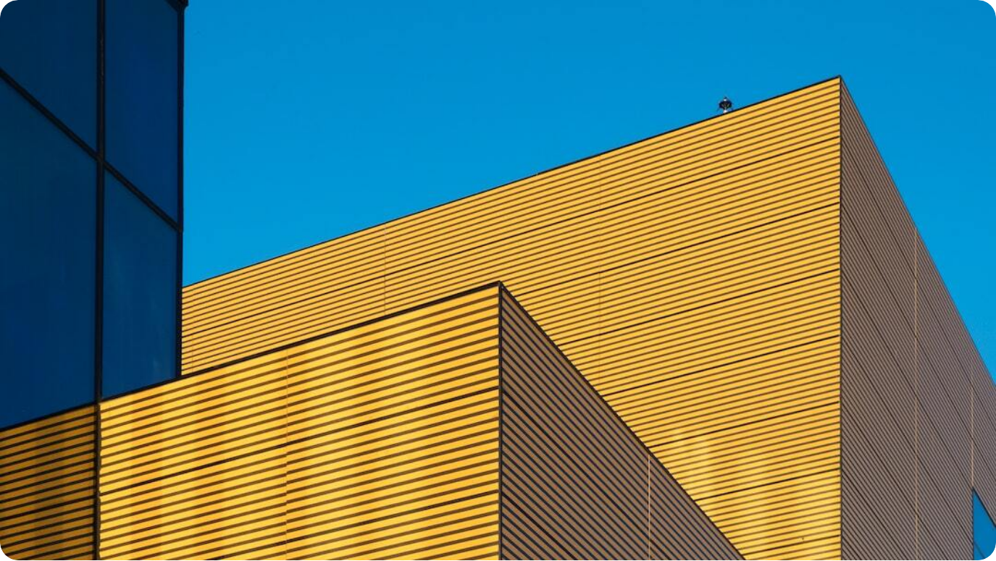
Specific Uses in Detail
PVC Cladding & Siding
Exterior Protection: PVC cladding shields buildings from rain, wind, and moisture infiltration.
Low Maintenance: Requires minimal upkeep compared to wood or metal cladding.
Aesthetic Variety: Available in different colors and textures, enhancing building appearance.
Photo by Oleg Laptev on Unsplash
Notes:
PVC cladding and siding are commonly used to enhance and protect building exteriors. Their primary function is to provide a durable barrier against harsh weather conditions, including rain and wind.
Unlike wood cladding, which requires frequent painting or sealing, PVC cladding offers a virtually maintenance-free alternative. Its resistance to moisture also prevents issues like rot, mold, and insect infestation.
Additionally, PVC cladding is manufactured in a wide range of colors, styles, and textures, allowing architects and homeowners to achieve the desired aesthetic without compromising performance or longevity.

Slide 11
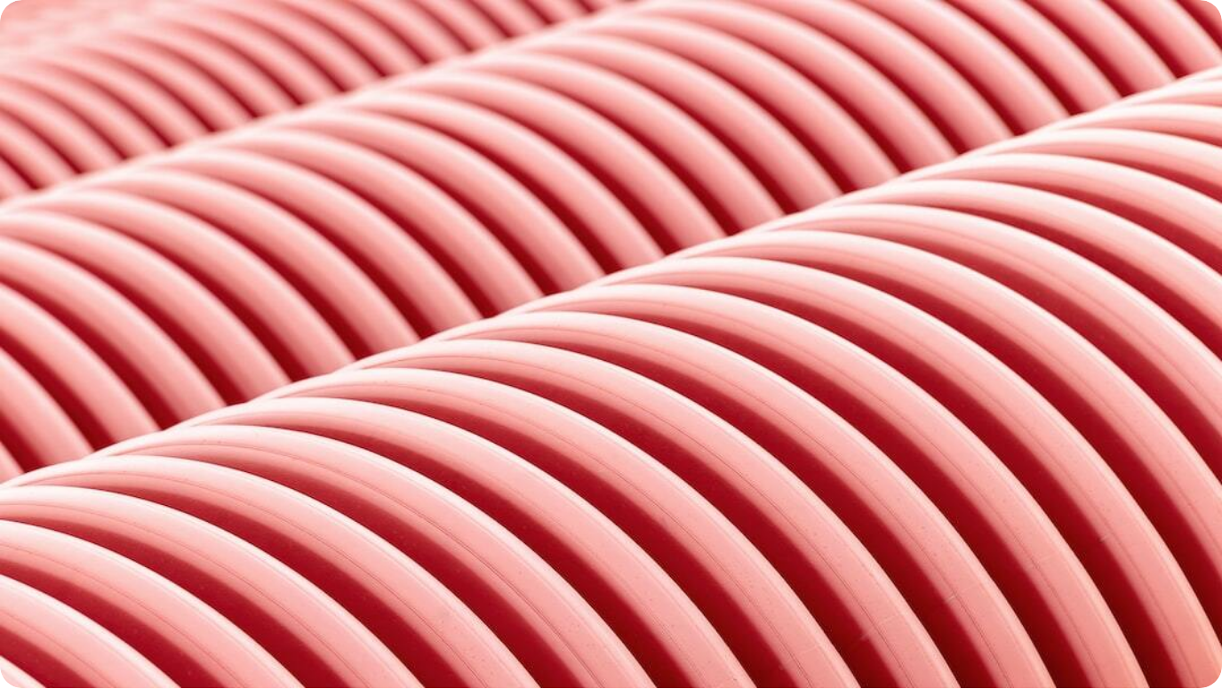
Specific Uses in Detail
PVC Electrical Conduits
Cable Protection: PVC conduits protect electrical wiring from mechanical damage and moisture.
Non-Conductive: PVC’s insulating properties enhance safety in electrical systems.
Flame-Retardant: Inherently flame-resistant, reducing fire risks in wiring installations.
Photo by Pawel Czerwinski on Unsplash
Notes:
PVC is also a preferred material for electrical conduits, which serve as protective casings for wires and cables. These conduits prevent mechanical damage and shield wiring from environmental factors like moisture.
The non-conductive nature of PVC provides an extra layer of safety, ensuring that electrical currents remain confined within the cables. This reduces the risk of accidental shocks or short circuits.
Additionally, PVC conduits are flame-retardant, meaning they do not sustain combustion. This critical property enhances fire safety, making PVC the standard choice for protecting electrical infrastructure worldwide.

Slide 12
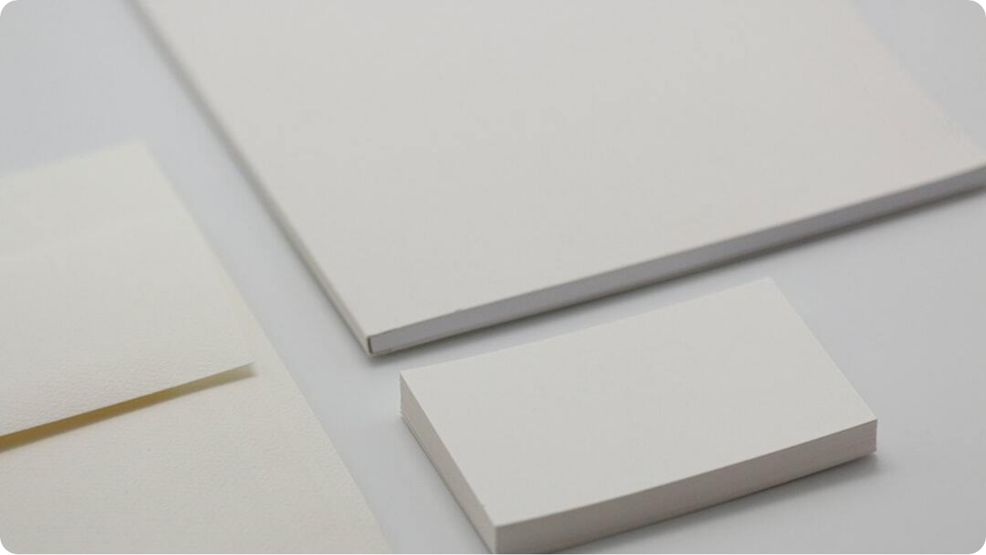
PVC vs. Aluminum
Material Comparison
Material Type: PVC is a plastic polymer, whereas aluminum is a metal element.
Weight: PVC is very lightweight, while aluminum is light but heavier than PVC.
Durability: PVC resists corrosion and chemicals, while aluminum resists corrosion but can oxidize.
Photo by Brando Makes Branding on Unsplash
Notes:
When comparing PVC to aluminum, the differences are striking and influence their use in construction. PVC, being a plastic polymer, offers a completely different performance profile than aluminum, which is a metallic element.
In terms of weight, PVC is lighter than aluminum, simplifying transportation and installation, particularly in large-scale projects. This quality makes PVC an attractive option where labor and logistical costs are key concerns.
Durability is another distinguishing factor. While aluminum resists corrosion better than steel, it is still prone to oxidation, which can affect its surface over time. PVC, in contrast, is immune to corrosion, chemical damage, and rust, making it highly reliable for environments where exposure is a concern.

Slide 13
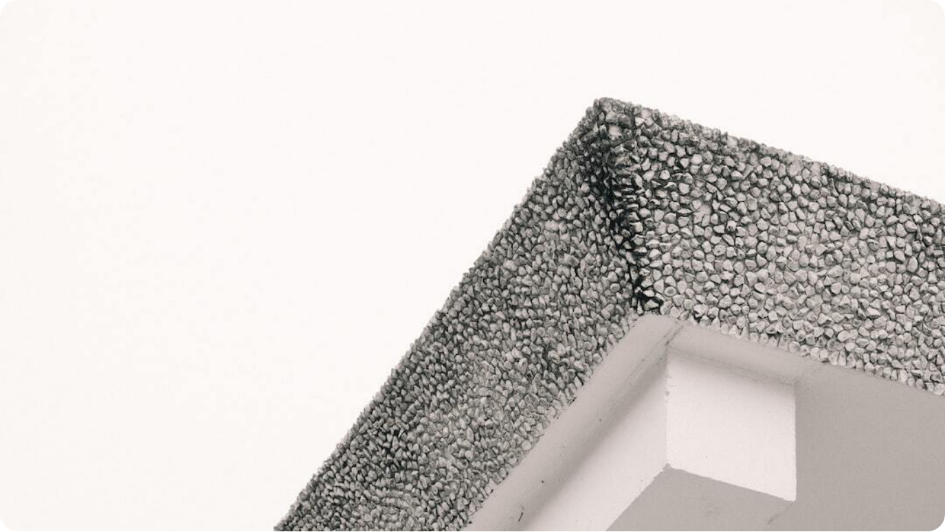
PVC vs. Aluminum
Insulation, Maintenance, and Cost
Insulation: PVC provides excellent thermal and sound insulation, unlike aluminum, which requires added thermal breaks.
Maintenance: PVC requires minimal upkeep, while aluminum may need periodic cleaning.
Cost: PVC is generally more cost-effective compared to aluminum.
Photo by IKE on Unsplash
Notes:
Looking deeper into performance factors, PVC excels in insulation. It offers excellent thermal and acoustic properties, which makes it valuable in building envelopes such as windows and cladding. Aluminum, by contrast, is a poor insulator and requires additional design measures like thermal breaks to achieve comparable performance.
Maintenance is another area of difference. PVC requires almost no maintenance—no painting, sealing, or frequent attention is necessary. Aluminum fares better than steel in this regard, but it can still require regular cleaning and occasional protective treatments.
Cost considerations usually tilt the balance in favor of PVC. It is significantly more affordable upfront and over its lifecycle compared to aluminum, making it the material of choice for budget-sensitive projects.

Slide 14
PVC vs. Aluminum - Applications
Where Each Excels
PVC Applications: Ideal where cost, insulation, and corrosion resistance are critical. Examples: window frames, pipes, siding, and doors.
Aluminum Applications: Suited for strength and modern aesthetics. Examples: curtain walls, large window frames, and facades.
Key Difference: PVC is chosen for affordability and efficiency, while aluminum is chosen for sleek structural finishes.
Photo by Brando Makes Branding on Unsplash
Notes:
PVC and aluminum each have unique application domains based on their properties. PVC is most commonly chosen where cost-effectiveness, insulation performance, and resistance to corrosion are critical. Typical examples include window frames, piping systems, siding, and doors.
Aluminum, on the other hand, is selected for its strength-to-weight ratio and modern aesthetic appeal. It is particularly well-suited for large-scale architectural applications, such as curtain walls and commercial facades, where its sleek appearance enhances the design.
The key takeaway is that PVC and aluminum are not direct competitors in all cases, but rather complementary materials serving different construction needs.

